Slide 1

Unit 04.01.02
CS 5220:
COMPUTER COMMUNICATIONS
IP Addressing
XIAOBO ZHOU, Ph.D.
Professor, Department of Computer Science

Slide 2
IP Addressing
Each host on Internet has unique 32 bit IP address
Each address has two parts: netid and hostid
netid is unique & administered by Internet registration
netid facilitates routing and reduces routing table
A separate address is required for each physical connection of a host to a network; “multi-homed” hosts
Dotted-Decimal Notation:
  int1.int2.int3.int4 where intj = integer value of jth octet
  IP address of 10000000 10000111 01000100 00000101
  is 128.135.68.5 in dotted-decimal notation

Slide 3
Classful Addresses
Class A
7 bits
24 bits
0
netid
hostid
126 networks with up to 16 million hosts
1.0.0.0 to
127.255.255.255
Class B
14 bits
16 bits
1
0
netid
hostid
16,382 networks with up to 64,000 hosts
128.0.0.0 to
191.255.255.255
Class C
21 bits
8 bits
1
1
0
netid
hostid
2 million networks with up to 254 hosts
192.0.0.0 to
223.255.255.255

Slide 4
Class D Addresses
Class D
28 bits
1
1
1
0
multicast address
224.0.0.0 to
239.255.255.255
Up to 250 million multicast groups at the same time
Permanent group addresses
  All systems in LAN; All routers in LAN;
  All OSPF routers on LAN; All designated OSPF routers on a LAN, etc.
Temporary groups addresses created as needed
Special multicast routers

Slide 5
Reserved Host IDs (all 0s & 1s)
Internet address used to refer to network has hostid set to all 0s
this host
(used when
booting up)
0
0
0
0
0
0
a host
in this
network
0
0
0
host
Broadcast address has hostid set to all 1s
broadcast on local network
1
1
1
1
1
1
1
1
broadcast on distant network
netid
1
1
1
1
1

Slide 6
Private IP Addresses
Specific ranges of IP addresses set aside for use in private networks (RFC 1918)
Use restricted to private internets; routers in public Internet discard packets with these addresses
Range 1: 10.0.0.0 to 10.255.255.255
Range 2: 172.16.0.0 to 172.31.255.255
Range 3: 192.168.0.0 to 192.168.255.255
Network Address Translation (NAT) used to convert between private & global IP addresses

Slide 7
Example of IP Addressing
128.135.40.1
128.140.5.40
H
Interface
Address is
128.135.10.2
Interface
Address is
128.140.5.35
H
Network
128.135.0.0
R
Network
128.140.0.0
What class types?
H
H
H
128.135.10.20
128.135.10.21
128.140.5.36
Address with host ID=all 0s refers to the network
Address with host ID=all 1s refers to a broadcast packet
R = router
H = host

Slide 8
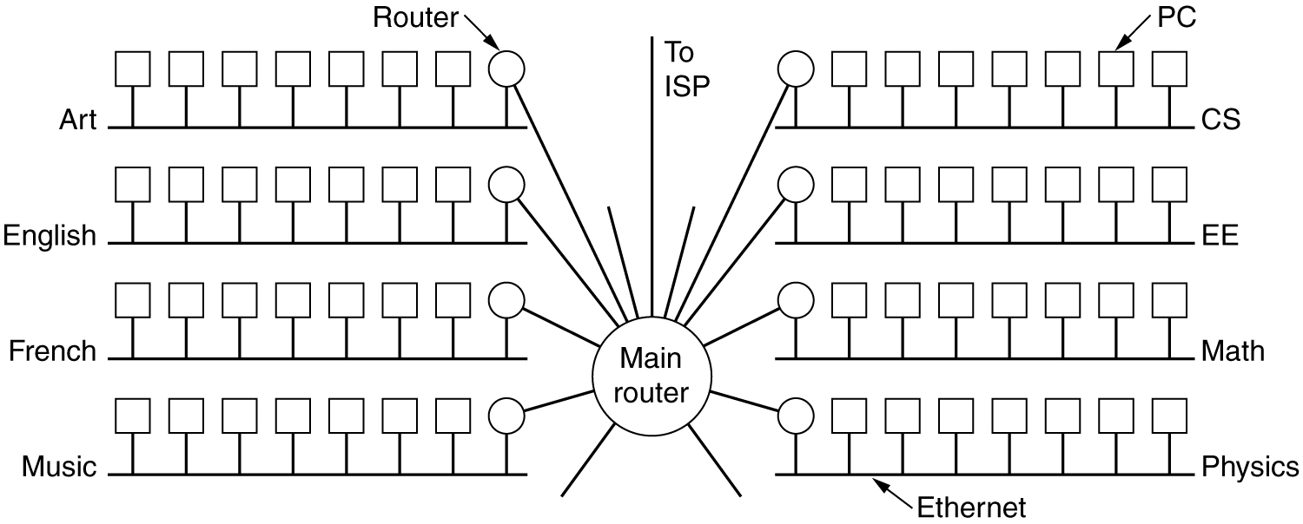
Subnets
A campus network consisting of LANs for various departments.
- How to allow a network to be split into several parts for internal use but still act like a single network to the outside

